Slide 1
Authorship Verification
Xinzhao You and Jiangpeng Liu

Slide 2
Introduction
Problem: The core task is Authorship Verification. Can we algorithmically determine if two different text samples were written by the same person?
Goal: Use Natural Language Processing (NLP) to analyze linguistic style and identify patterns indicating single or multiple authors.
Motivation: Identifying the single author behind multiple anonymous online accounts used for disinformation campaigns.
With the new model, we might be able to determine if Elon Musk has an alt account.

Slide 3
Data
Datasets:
Pan13 Dataset and Pan15 Dataset
Tweets from public figures (e.g., Elon Musk, Donald Trump).
Collection: Web scraping for Gutenberg data
Challenges: Potential issues include data preprocessing and selecting appropriate features (like sentence length).

Slide 4
Methodology
Core Algorithm: Utilizing BERT (Bidirectional Encoder Representations from Transformers) models.
Tools: Using existing libraries like PyTorch and Transformers.
Exploration: Considering variants like ConvBERT and ModernBERT for potential improvements

Slide 5
Related Work
Key Differences from Prior Work:
While some previous work used traditional methods like Random Forests or CNNs, this project focuses on advanced Transformer models like BERT.
Distinguishes from related tasks like genre classification

Slide 6
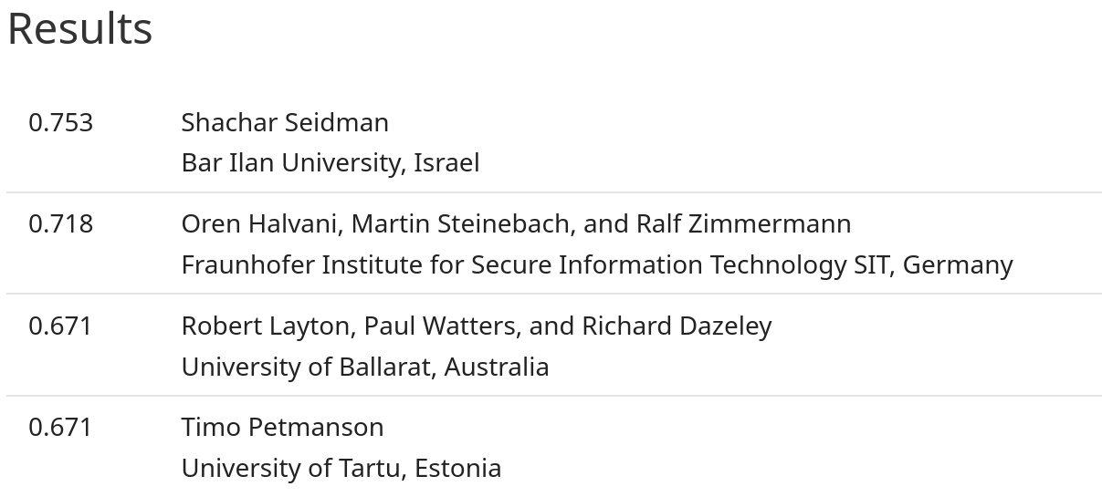
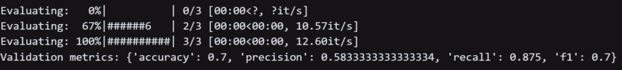
Current Status
Downloaded and initially explored the Gutenberg and PAN 2015 datasets
Datasets other than Pan 2015 requires too much hardware resources on our available hardware (RTX 4080S)
Wrote a BERT base model for authorship verification
Current average F1 score: 0.7

Slide 7
Conclusion
Remaining Steps:
(This Week) Optimizing our model, tuning hyperparameters, and experimenting with other BERT variants.
Conclusion
Our project is focused on developing a robust NLP-based method for authorship identification, specifically aiming to determine if different texts originate from the same author. By leveraging advanced deep learning models like BERT and its variants, we aim to improve upon existing techniques.

